Slide 1
Week 5
Front-end Development
DOM Programming

Slide 2
Agenda!
From HTML to the DOM
Introduction to DOM
Nodes & types
Programming the DOM
Finding and getting references
Creating and modifying elements
Inspecting and modifying a DOM element
Events – Most imp.
Some demo code!
Timers
A complete project – Talking of JS and HTML, CSS! ☺

Slide 3
From HTML to the DOM
Let’s make HTML,CSS and JavaScript talk to each other!
Up until now, we have learned them separately.
How can they communicate with each other?
DOM is an API – Just for information!
API – Application programming interface – Website talking to website

Slide 4
DOM – Document Object Model
It allows us to treat HTML document as a tree with upside down root
By using this tree, we can do a lot of wonderful things with HTML and CSS and JavaScript!
Let’s see a DOM Tree:

Slide 5
<!DOCTYPE html>
<html>
<head>
<title>This is a Document!</title>
<meta charset="utf-8">
</head>
<body>
<h1>Welcome!</h1>
<p>This is a paragraph with a <a href="index.html">link</a> in it.</p>
<ul>
<li>first item</li>
<li>second item</li>
<li>third item</li>
</ul>
</body>
</html>

Slide 6
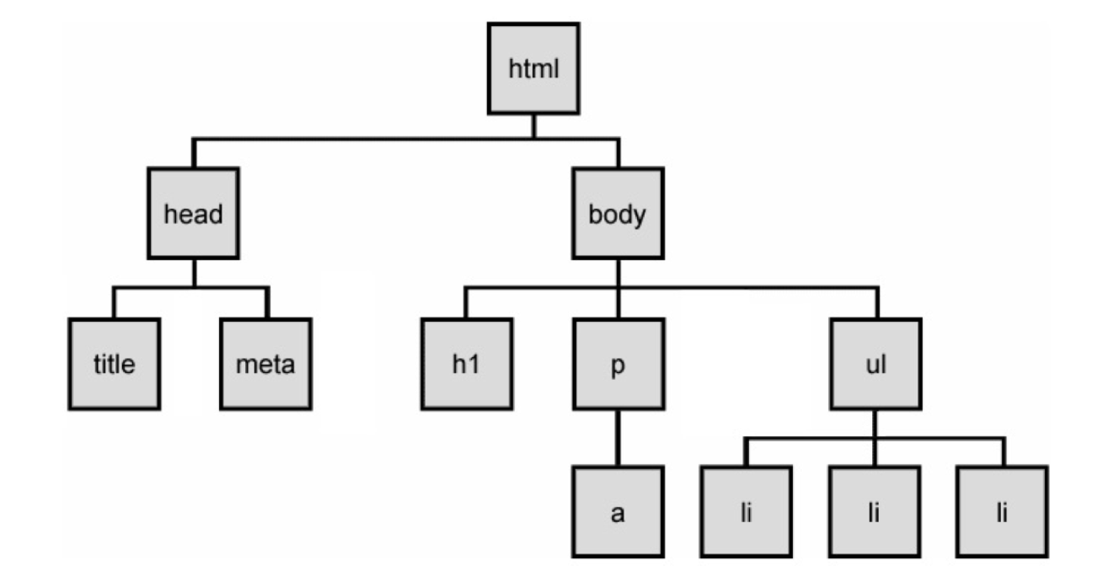

Slide 7
Some useful information…
The DOM Tree consists of DOM Nodes, which represent various parts of a document, including elements, attributes, and comments
While we often use "nodes" and "elements" interchangeably since all elements are nodes within the tree, there are other node types as well, such as text nodes (which hold the text within block elements) and attribute nodes (which store key/value pairs)

Slide 8
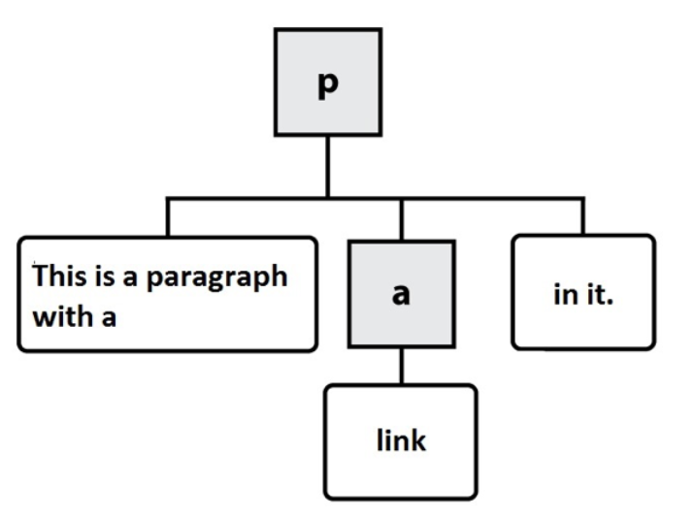
Consider the <p> element from this example:
<p>This is a paragraph with a <a href="index.html">link</a> in it.</p>

Slide 9
Nodes and types
HTML Nodes: All html elements are called HTML nodes.
Text Nodes: All text values are called text nodes...

Slide 10
Programming the DOM
Finding and getting references to elements in the page
a) document.getElementById(id)
b) document.querySelector(selector)
c) document.querySelectorAll(selector)
selector: i) "tag name"
ii) Id selectors (#)… document.querySelector(“#item1”);
iii) class selectors(.) .. document.querySelectorAll(“.demo”);

Slide 11
2. Creating elements and Modifying the DOM with JavaScript
document.createElement(name): creates a new element of type specified by the name.
document.createTextNode(text): creates a new text node(the text withing an elements vs the element itself)
appendChild();
append(); // when we are upending something not element

Slide 12
3. Inspecting and modifying a DOM element with JavaScript
Properties:
element.id -
element.innerHTML - gets or sets the markup contained within the element.innerText - gets or sets the text withing the element
element.parentNode - gets a reference to the parent node of this element.nextSibling - gets a reference the sibling element of this element, if any..
element.className - gets or sets the value of class attribute

Slide 13
4. Events: DOM heavily replies on a concept know as "event-driven programming"
The examples of events might: user actions(clicking a button, move the mouse over , pressing a key, changing tab) or browser/code initiated actions(timers,messages from background, reports from sensors)
the functions that run on any triggered event are called "event handlers"

Slide 14
We register a DOM event in one of the two ways:
1. element.onevent = function()={ } //modern day we don’t use it
2. element.addEventListener("event", function(){... }) & element.removeEventListener('event', function(){ ....})

Slide 15
Common Events:
load - fired when a resource has finished loading...(img)
click - when user single clicks on an element
dblclick - when use double clicks on an element
keypress - when a key is pressed
mouseover - when the user moves the mouse over the top of the element.

